Slide 1
Agile Communication
Project

Slide 2
Agile Communication
Project
Sprints 1-3

Slide 3
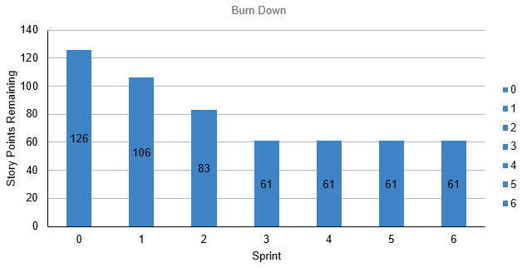
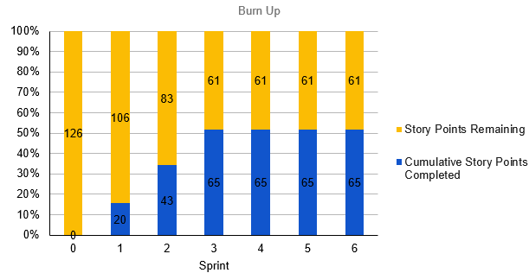
Sprints 1-3 Questions
What is your Velocity for the past 3 sprints?
[22]
How do you know your Velocity is correct?
[（20+23+22）/ 3 = 22]
What would the BURN DOWN chart look like for Sprints 1-3?
[Place your chart to the right]
What would the BURN UP charts look like for Sprints 1-3?
[Place your chart to the right]
How many points do you think the Team should commit to for Sprint 4 and justify your answer?
[Around 22, the velocity is supposed to be a stable number]

Slide 4
Agile Communication
Project
Sprint 4

Slide 5
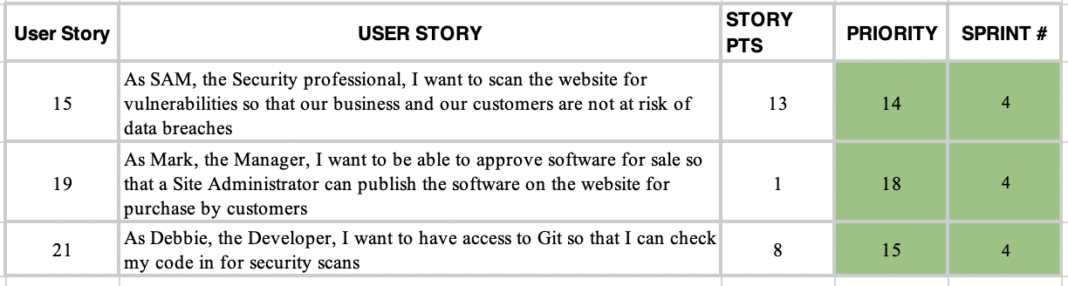
Sprint 4 user stories

Slide 6
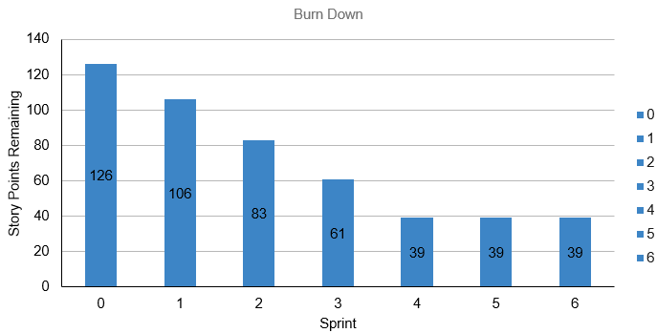
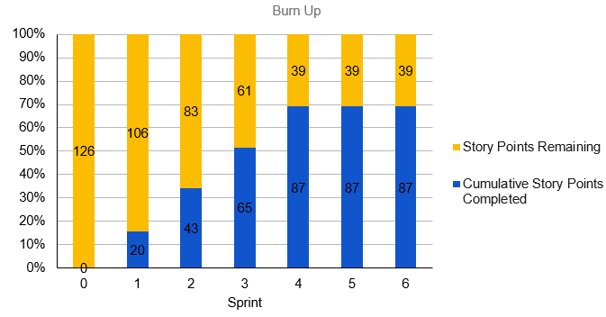
Sprint 4 Questions
What would the BURN DOWN chart look like for Sprints 1-4?
[Place your chart to the left]
What would the BURN UP charts look like for Sprints 1-4?
[Place your chart to the left]
What Risks did you identify in Sprint 4 and how do they affect the project? (Note: These would be your narrative findings)
[technical complexity around secure credit card handling and vulnerability scanning poses a risk of delays and compliance issues. Additionally, dependencies on managerial approvals and Git access could create bottlenecks that impact sprint completion.]
What Theme or Name did you give to Sprint 4?
[Fortify]

Slide 7
CodeStorm
Sprint 4 Name
“Fortify “
User Stories in Sprint 4
1. Story # 15 with 13 points 2. Story # 21 with 8 points 3. Story # 19 with 1 points vulnerabilities Total Sprint 4 Points: 22
Narrative:
Results:In Sprint 4, Sam, the security professional, successfully identified and fixed vulnerabilities on the website to enhance security. Meanwhile, Debbie, the developer, ensured that the necessary software was installed on her system and gained access to Git for secure code management and version control.Learnings:We learned that prioritizing security in the early stages of development is critical to safeguard customer data and prevent potential breaches. Additionally, ensuring proper access to development tools like Git is essential for a smooth, secure workflow.Risks:The primary risk identified was that any unresolved vulnerabilities could lead to data breaches, compromising sensitive customer information and undermining trust in the platform. This could delay the project’s progress and affect the timely release of the MVP.
SPRINT 4 DEMO of Working Product

Slide 8
Agile Communication
Project
Sprint 5

Slide 9
Sprint 5 user stories

Slide 10
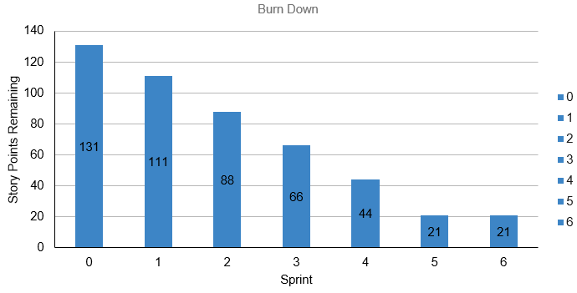
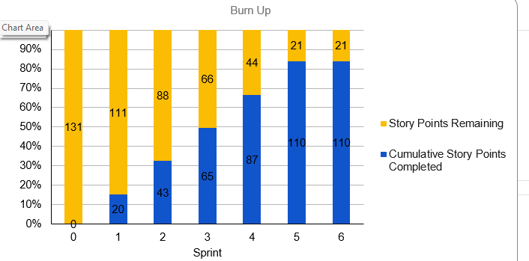
Sprint 5 Questions
What would the BURN DOWN chart look like for Sprints 1-5?
[Place your chart to the left]
What would the BURN UP charts look like for Sprints 1-5?
[Place your chart to the left]
What Risks did you identify in Sprint 5 and how do they affect the project? (Note: These would be your narrative findings)
[Your Answer]
How confident are you in delivering all of the user stories by the end of Sprint 6? Justify your answer.
[Your Answer]

Slide 11
CodeStorm
Sprint 5 Name
“Optimization“
User Stories in Sprint 5
1.Story # 18 with 13 points 2. Story # 22 with 5 points 3. Story # 14 with 5 points Total Sprint 5 Points: 23
Narrative: Mark, the Manager, will work to ensure software approval processes are streamlined for efficient publishing by the Site Administrator.Debbie, the Developer, will focus on optimizing the website’s performance to achieve faster load times. Results:Software approval process improved, allowing faster product publishing.Website load time decreased to meet the 3-second target. Learnings:Optimizing approval workflows can enhance the speed of bringing products to market.Improving site load time contributes directly to a better user experience and customer retention. Risks:Delays in the approval process could impact the timely release of new software products.Site performance issues, if not fully resolved, could lead to user frustration and decreased traffic.
SPRINT 5 DEMO of Working Product

Slide 12
Agile Communication
Project
Sprint 6

Slide 14
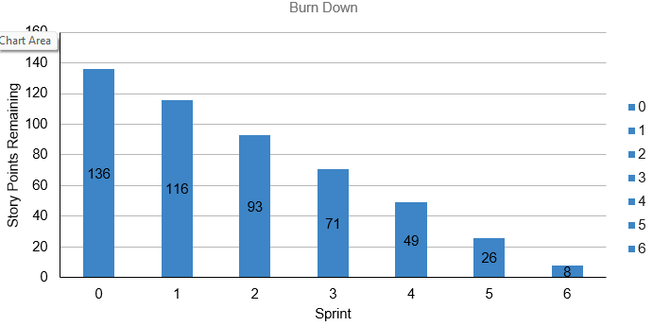
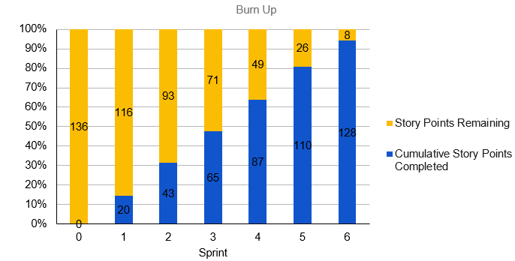
What would the BURN DOWN chart look like for Sprints 1-6?
[Place your chart to the left]
What would the BURN UP charts look like for Sprints 1-6?
[Place your chart to the left]
Was the Team able to complete all the work in the backlog or did you have to adjust what could be delivered? How would you tell this to Management and justify your answer.
[No, we could not. Due to the prevalent of cyber attack and to meet the requirements collected from the user interview, the story points increased unexpectedly. The team could not ideally deal with the external changes.]

Slide 15
CodeStorm
Sprint 6 Name
“Quick Response“
User Stories in Sprint 6
1. Story # 23 with 5 points 2. Story # 17 with 5 points 3. Story # 16 with 8 points Total Sprint 6 Points: 18
Narrative - Team launches a BOGO promotion as a quick response to the global pandemic to save the profits. Results - The quick response mitigate the impact caused by the pandemic. The code quality improvement was postponed to the next Sprint. Learnings - always make quick response to the fast-changing market Risks - The strategy may change in response to the pandemic.
SPRINT 6 DEMO of Working Product

Slide 16
BVIR for Management Questions
Which charts would you want to include in the BVIR that Management would need and why?
Move the Orange boxes to the correct column below
[We utilize burn down charts to monitor the progress of each sprint, while burn up charts focus on the overall iterations. Burn up charts also highlight the addition of new tasks over time. Additionally, teams use the Committed vs. Delivered Chart to track their planned story points and compare them with the actual points delivered.]
Included
Not included
Burn Down Charts
Story Point Cost per Team
Burn Up Charts
Committed vs. Delivered Chart

Slide 17
Creating the BVIR for Management
Questions to answer before you start the BVIR
What would tell Management if they want to know the details about actual stories?
[Select from the choices below]
"While I understand that you want to get into individual stories and know all the details, we would prefer that Management spends your valuable time guiding and influencing the Roadmap and direction of the project and leave the story delivery to the Teams you have empowered."
Absolutely, let's get into the details!
No, that is none of your business
Which of the above did you choose (1,2,3) and why?
[1 - The Roadmap and direction of the project were correct. This response respects Management’s role while reinforcing Agile principles of team autonomy and trust. It ensures Management focuses on strategic direction, while the empowered team handles execution.]

Slide 18
Creating the BVIR for Management
Questions to answer before you start the BVIR
Is it project considered a failure because backlog items still remain? Explain.
[No, the project is not considered a failure just because backlog items remain. In Agile, it is normal for the backlog to evolve continuously; success is measured by delivering a working MVP that meets the highest-priority customer needs within the planned timebox.]

Slide 19
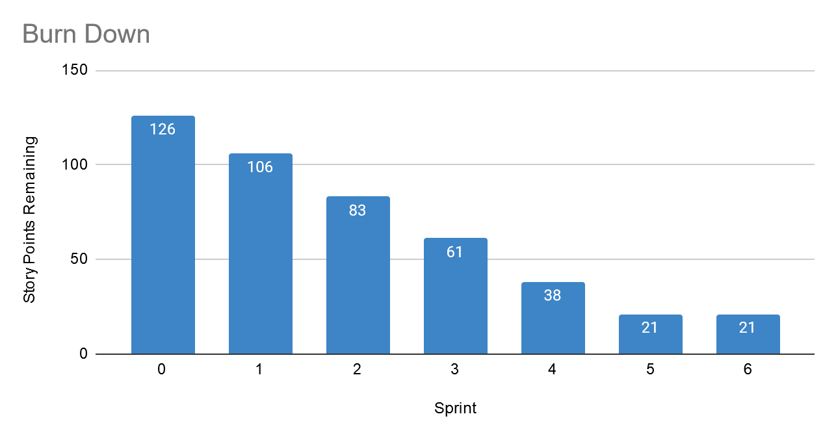
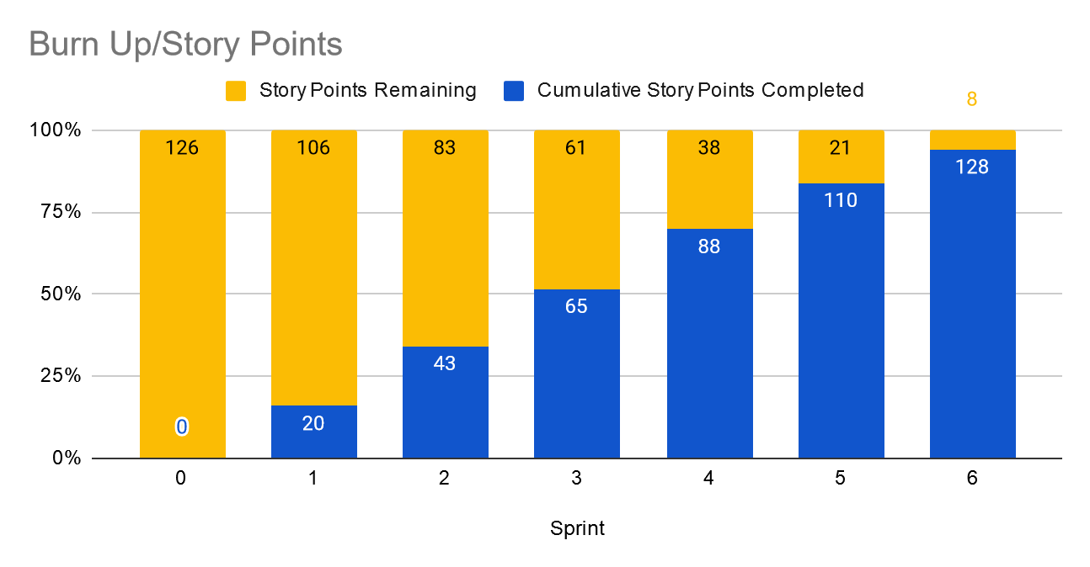
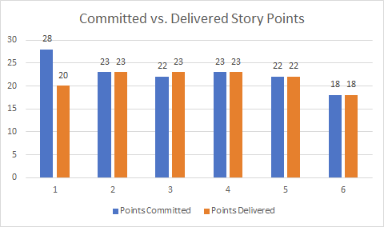
Creating the BVIR for Management
Instructions:
Start by creating your own BVIR. From the charts and sections below, please drag and drop items you would like to display to convey the story behind the MVP project
[Cut and paste items from this section and add them to the next slide. Remember to fill in information in the boxes where it is needed]
Roadmap
MNP Vision: We are building a world class e-commerce platform aiming at provide the world-class online shopping experience.
CodeStorm
Chart Comparing Sprint Velocity of Teams 1 vs Team 2
Chart showing cost per story point

Slide 20
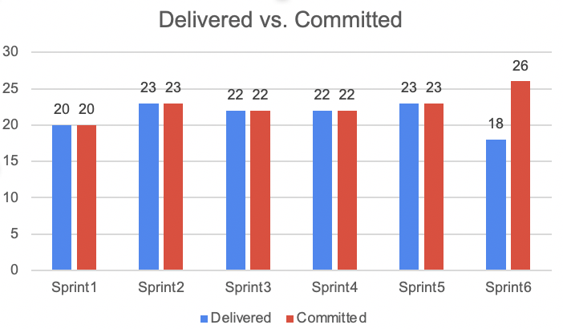
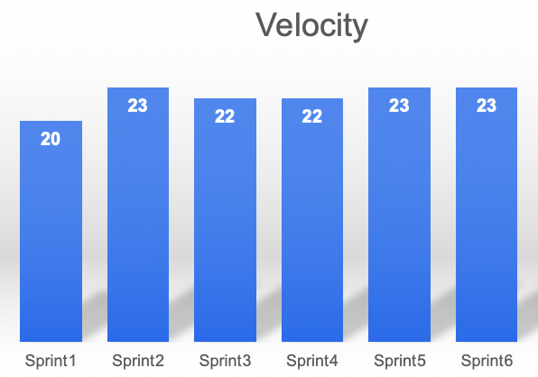
BVIR for Management
[Use this slide to create your BVIR. We have not provided a template for this, you get to decide what it looks like using the information from the previous slide]

Slide 21
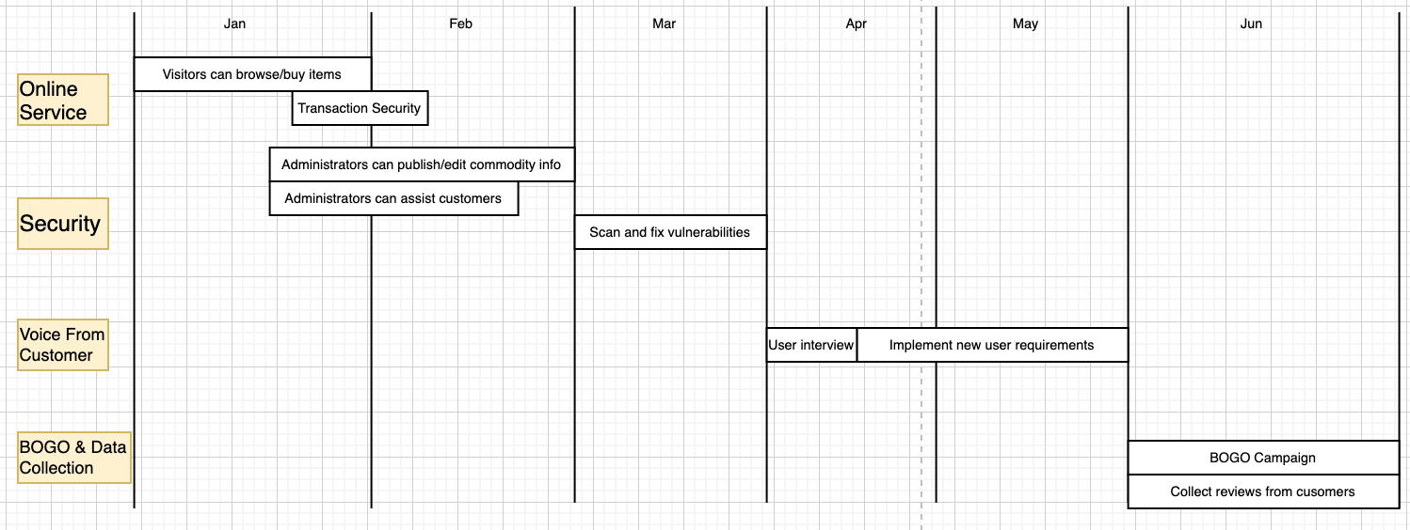
Roadmap

Slide 22
BVIR for Management
[Now that you have created your BVIR for management, you need to create a video or written narrative explaining the MVP delivery status.
Use this slide to write your narrative or plan what you want to say in your video. ]
Include (at the minimum) the following:
Team Name: CodeStorm 2.Vision: To deliver a modern, secure, and high-performing website that enables customers to easily browse, purchase, and interact with our software offerings while empowering internal teams with the tools they need to manage operations efficiently. 3.Sprint Burn Down and Burn Up Charts (Sprints 1–6):Throughout the six sprints, burn down charts have shown a consistent reduction in story points, indicating steady progress. Burn up charts reflect the accumulation of completed work and clearly show that our MVP scope has been delivered as planned, with a few remaining lower-priority backlog items. 4.Project Status: ✅ Complete The Minimum Viable Product (MVP) has been successfully delivered within the six sprint timeline. All critical user stories required for MVP are complete, and the product is ready for canary rollout as scheduled. Remaining items in the backlog are enhancements and not blockers for release.

Slide 23
Questions from Management (Using Videos would be great!)
Instructions:
Watch the videos in the classroom.
Record your videos or provide your answers below. Remember to justify your answer.
[Video #1 Answer] Hi Ms. CFO, one of Agile’s key principles is embracing iteration. While the initial release isn’t perfect, it includes the core functionality and has been well-received by users. We’ll continue to improve it through ongoing feedback and updates, making it safe and valuable to release now. [Video #2 Answer] Hi Ms. CMO, we acted swiftly in response to industry trends. Given the rise in cyberattacks affecting many software companies, addressing vulnerabilities immediately—rather than sticking rigidly to the original plan—helped us avoid greater risk and protect both users and business assets. [Video #3 Answer] Hi Mr. CEO, while around-the-clock work might offer a short-term fix, it's not sustainable. Agile promotes maintaining a steady, consistent work pace to protect team health and ensure long-term productivity without burnout. [Video #4 Answer] Absolutely—let’s move forward and bring this project to completion with full commitment.

